Slide 1
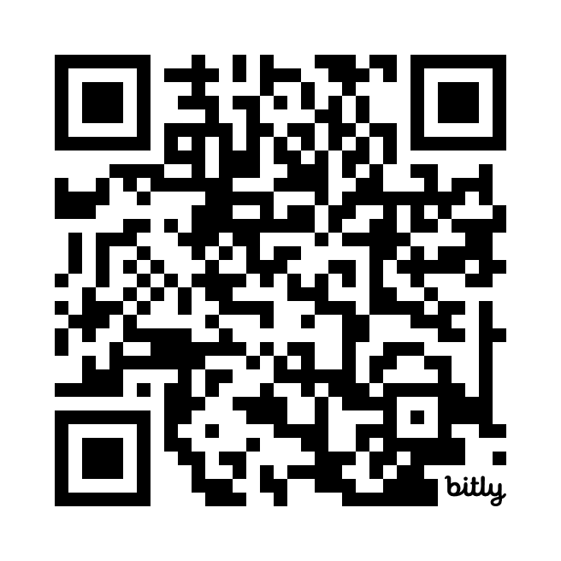
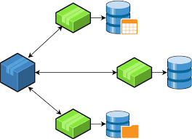
Lab 05 - Distributed Transactions and TLA+
https://bit.ly/4idVqKq

